Slide 1

Tehnici Web CSS3(II) RESPONSIVE WEB DESIGN
Ioana Leustean
Sem.II, 2016

Slide 2
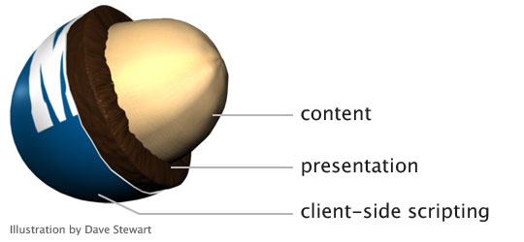
Progressive Enhancement
Steven Champeon Nick Finck
http://alistapart.com/article/understandingprogressiveenhancement

Slide 3
Referinte
Addaptive Web Design
Aaron Gustafson
Desiging with Web Standards
Jeffrey Zeldman, Ethan Marcotte
A List Apart for people who make websites
Smashing Magazine

Slide 4

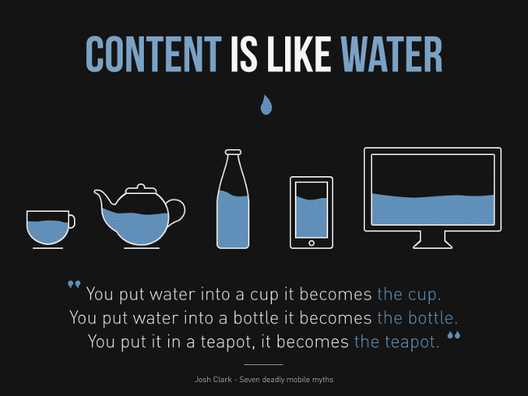
ADAPTIVE/MOBILE FRIENDLY
RESPONSIVE
vs
flexible and fluid grids
predefined screen sizes
http://torquemag.io/responsive-design-vs-adaptive-design/

Slide 5
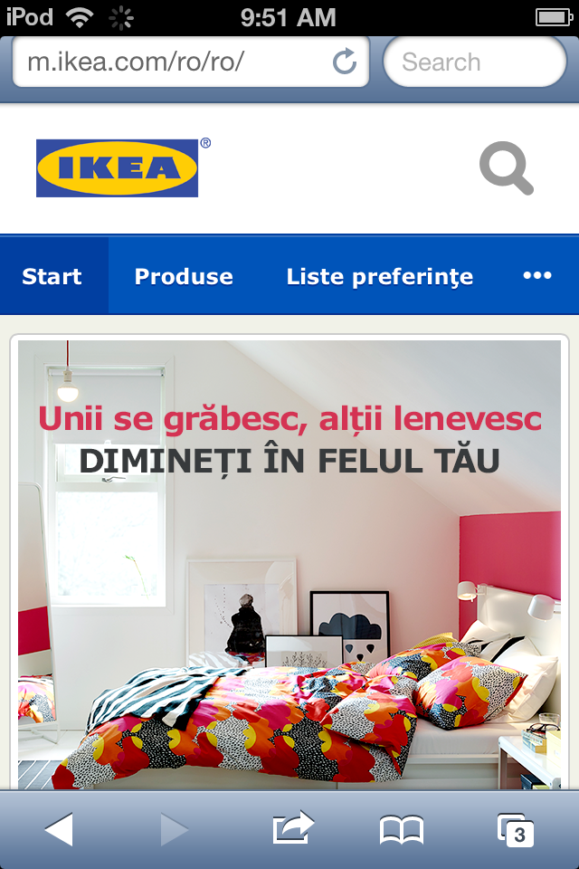
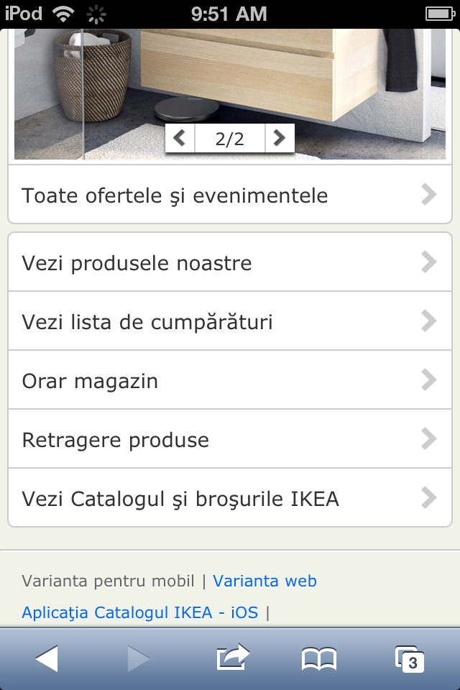
Adaptive/ Mobile Friendly
Server-side scripting, software
care detecteaza dispozitivul userului
Mai variante ale siteului
(cate una pentru fiecare
dimensiune a ecranului)
Subdomenii specifice
Ex: m.ikea.com/ro/ro
Utilizatorul poate alege intre
varianta pentru mobil si varianta web

Slide 6
Responsive Web Design
Ethan Marcotte
http://alistapart.com/article/responsive-web-design
“Fluid grids, flexible images, and media queries are the three technical ingredients for responsive web design, but it also requires a different way of thinking. Rather than quarantining our content into disparate, device-specific experiences, we can use media queries to progressively enhance our work within different viewing contexts.”

Slide 7
HTML atributul media
Permite folosirea unor stiluri CSS diferite in functie de proprietatitle dispozitivului media care prelucreaza pagina,
De exemplu, o pagina poate avea stiluri diferite pentru
afisare sau printare.
media = speech
<!-- braille, handheld, print, projection, screen, tty, tv -->
HTML
<head>
<link rel="stylesheet" type="text/css" media="screen" href="sans-serif.css">
<link rel="stylesheet" type="text/css" media="print" href="serif.css">
</head>
CSS
@media screen { * { font-family: sans-serif } }

Slide 8
CSS at-rule @media
@media media-query1, media-query2{}
media type
screen, print,
speech, braille,
handheld, projection,
tty, tv
Proprietatea HTML media
media=“media-query1, media-query2”
media-query
med-type and (med-feature1:value) and (med-feature2:value)
http://www.w3.org/TR/css3-mediaqueries/
media features:
width, height, max-height, min-height,
max-width, min-width, color,
device-width, device-height,
orientation: portrait /*landscape */
aspect-ratio (16:9), resolution
only /* browserele vechi
ignora setarea*/
not /* neaga intreaga conditie*/

Slide 9
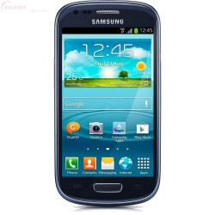
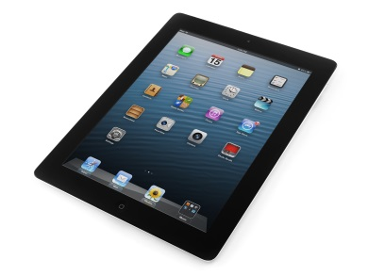
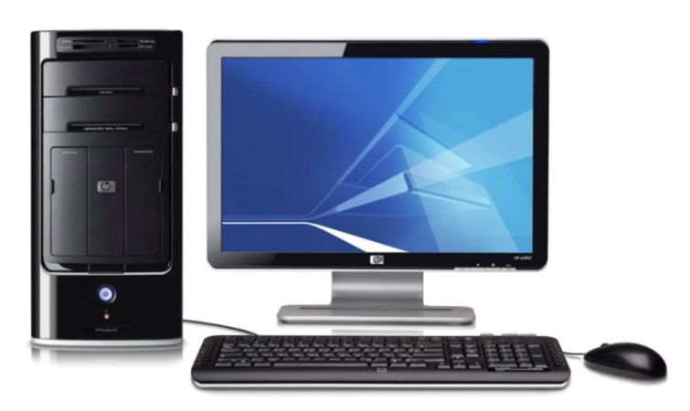
Exemple:
@media only screen and (min-width : 320px)
@media only screen and (min-width : 768px) and (orientation:portrait), screen and (max-width1024px)
<meta name="viewport" content="width=device-width, initial-scale=1">
@media only screen and (min-width : 1224px)
http://www.w3.org/TR/css3-mediaqueries/

Slide 10
Fluid layout
http://alistapart.com/article/fluidgrids
Pentru dimensiunie folosesc unitati de masura relative:
procente, ems, cuvinte cheie
Exemplu:
body { font: normal 100% Helvetica, Arial, sans-serif; }
/* browser default =16px */
Headline 1 - 20px
Headline 2 - 18px
Headline 3 - 16px
Main text - 14px
Sub text - 12px
Footnotes - 10px
Headline 1 - 1.25em (1.25 = 20 ÷ 16 )
Headline 2 - 1.125em ( 1.125 = 18 ÷ 16)
Headline 3 - 1em (1em = 16px)
Main text - 0.875em (0.875 = 14 ÷ 16)
Sub text - 0.75em ( 0.75 = 12 ÷ 16)
Footnotes - 0.625em ( 0.625 = 10 ÷ 16)
target ÷ context = result

Slide 11
Fluid (flexible, elastic) images
http://alistapart.com/article/fluid-images
elementele img (video, iframe)
nu se dimensioneaza in HTML
<style type=“text/css”>
#contianer{width:45%}
img, iframe, video
{width:100%;}
</style>
<html>
<div id=“container”>
<img …>
<video> </video>
<iframe> </iframe>
</div>
</html>
img, video{width:45%;height:auto;}
background-image:url(adresa-imagine);
background-size:cover;

Slide 12
aside{width:15%;
float:right;
}
#baralat{width:25%;
float:left;
font-size:1.2em;
}
@media screen and (max-width:500px){
body{font-size:0.5em;}
aside, #baralat {float:none;width:100%;}
}

